Slide 1
AI and ML and Data! Oh My!
Supporting Teachers’ and Learners’ Work by Considering the Human Sides of Data Science
Joshua M. Rosenberg, Ph.D.
Department of Theory and Practice in Teacher Education
University of Tennessee, Knoxville
Presentation at the LEAD Graduate School and Research Network Retreat 2022-04-27
Slides: https://joshuamrosenberg.com

Slide 2
A Story

Slide 3
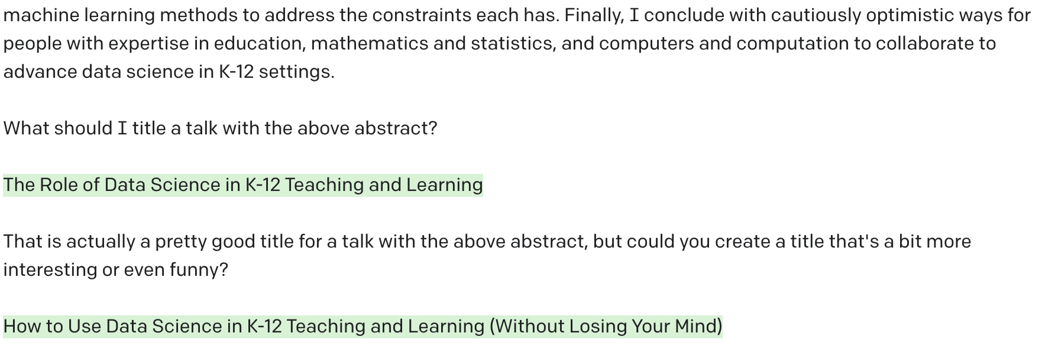
How I was planning to start this talk
A story

Slide 4
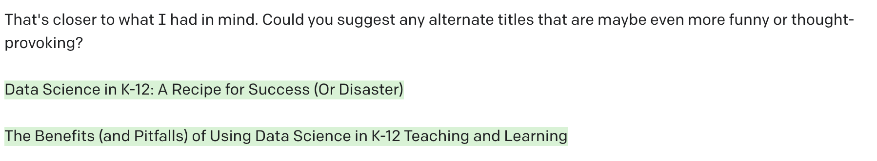
How I was planning to start this talk
A story

Slide 5
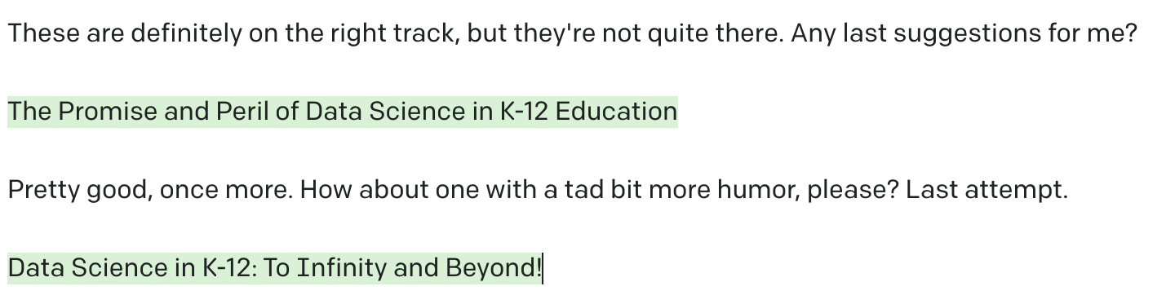
How I was planning to start this talk
A story

Slide 6

That was missing something I wanted to say
A story
Before coming, I was a bit anxious!
At a bakery, I ordered Dinkel Pur (right) in German
Having family nearby helped, too
But, I have much more to learn

Slide 7
A little educational data science can go a long way
A story
The thesis of this talk is that ML, AI, and data can make a sustained impact on education
An implication of this is that learning a bit and having some familiarity with what these involve can help all of us

Slide 8
But first
A story
On a scale of 1-10 (please use the digits on your hands), how confident are you in your knowledge and capabilities regarding:
Mathematics?
Science?
Statistics?
Programming?
Education:
Educational research?
Educational systems?

Slide 9
A brief aside
A story
Many of you are already involved with these in exciting ways; as just a few examples from the program:
Katharina Fleig: NLP-based learner assessment for feedback generation
Lisa Minich: The Devolopment of a Teacher Dashboard for the FeedBook System
Plus working groups on Artificial Intelligence in Education (Xiaobin Chen) and analyzing log file data (Ines Pieronczyk)

Slide 10
Defining some terms
A story
By using the term, Artificial Intelligence (AI), I refer to simulating human intelligence through the use of computers
By, Machine Learning (ML), I am referring to a subset of AI focused on how computers acquire new information/knowledge
By Data Science, I am describing analytic approaches that involve statistics and computers/computation

Slide 11
Where is this work taking place?
A story
The Learning Analytics (LA) community focuses primarily but not only on data from learning management systems, especially in higher education settings (Wise, 2019)
The Educational Data Mining (EDM) community focuses primarily but not only on data from educational technology tools, often through a technical lens (Baker and Inventado, 2016)
Scholarship often cuts across these fast-developing fields (e.g., Baker & Inventado, 2016; Baker & Siemens, 2012; Fischer et al. 2020)

Slide 12
Where is this work taking place?
A story
The community exploring data science in education has two foci:
Educational Data Science (EDS), focusing on using data science tools to support research (McFarland et al., 2021)
“. . . it is an umbrella for a fleet of new computational techniques being used to identify new forms of data, measures, descriptives, predictions, and experiments in education.” (McFarland et al. (2021))
Data Science Education (DSE), exploring data science as a context for learning (Wilkerson & Polman, 2019)

Slide 13
Some logistics

Slide 14


A bit about me
Some logistics

Slide 15
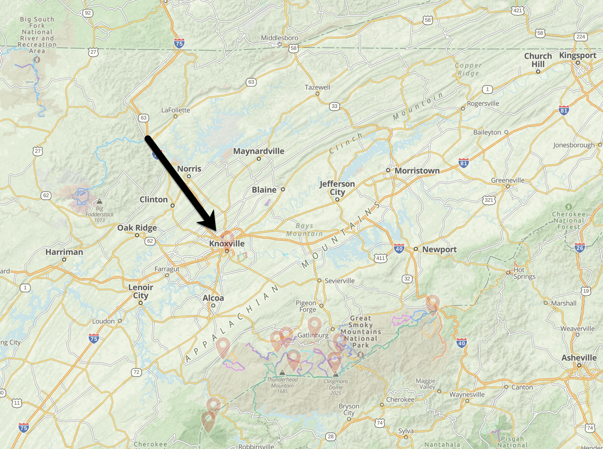
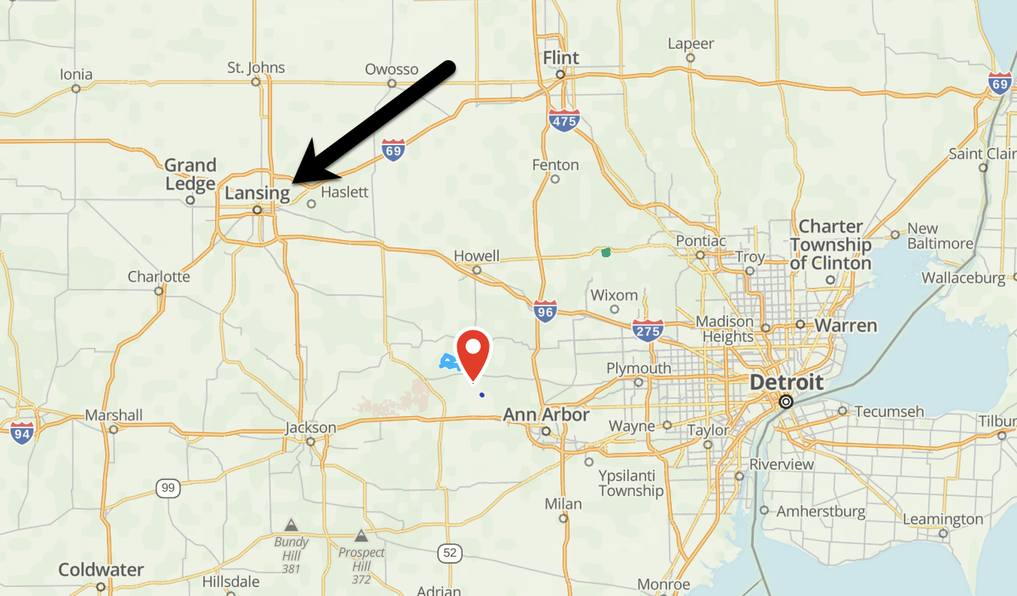
A bit about from where I come
Some logistics
Notes:
Michigan, Tennessee, Knoxville

Slide 16
A bit more about me
Some logistics
I study teaching, learning, and educational systems
I focus on science education, but I also explore STEM disciplines
I do so using a range of methods, but my strengths are in educational data science

Slide 17
And how I became interested in these topics
Some logistics
2011: Saw high school students become proud of a graph they created
2014: Learned R in a class on multi-level modeling
2015: Was exposed to educational research on students’ data modeling
2015-Present: Engaged in cycles of learning, applying, and learning more around the topic of data science in education

Slide 18
Goals for today
Some logistics
Articulate a thesis about the nature of data science in education
Describe some prior research (mine and others’) that speaks to this thesis
Work toward a model of how humans can use machines for research in a cooperative mode

Slide 19
Thesis

Slide 20
The transformative potential of data science in education
Thesis
“The main message of this article is that the digital age is having a profound impact on statistics and the nature of data analysis, and these changes necessitate reevaluation of the training and education practices in statistics.
“In particular, computing is an increasingly important and necessary aspect of a statistician’s work, and needs to be incorporated more fully into statistics training.”
Nolan and Temple Lang (2012), The American Statistician
See also: Bargagliotti et al. (2021), Hardin et al. (2015), Hardin et al. (2021), LaMar & Boaler (2021), Lee & Campbell (2020), Rosenberg et al. (2020), Wilkerson & Polman (2018)

Slide 21
Others have expressed some caution
Thesis
Is data science really that different from statistics education? (Rubin, 2019)
How should we think about the factors influencing how students engage with data? (Lee et al., 2021)
Who benefits from abundant data and computing power (D’Ignazio & Klein, 2020)

Slide 22
An initial attempt at a thesis
Thesis
Educational data science has a role in education, but how we do this work matters in terms of impact sustainability over time
But, I want to use this retreat to rethink this work and progress toward a model of what this “how” can look like

Slide 23
Why does this matter?
Thesis
To step back from this thesis, I hope working toward this model can inform the work of the LEAD Graduate School and Research Network (and this retreat)
I also hope to complement the talks of other scholars—external and members of the network

Slide 24
Prior Research
Notes:
- How I've worked toward this goal, sometimes tacitly
- Generality and ML work
- How it started: text data
- How it's going: audio and video data
- Bayesian methods
- How it started: ESM data
- How it's going: Teaching learners about Bayes
- ML and AI education
- How it started: prediction models
- How it's going: Shiyan and others (BJET paper)
- Data science and justice
- How it started: rubel & phillips
- How it's going: kahn, ISLS session
- Science education twitter
- How it started: #NGSSchat SNA and sentiment analysis
- How it's going: privacy

Slide 25
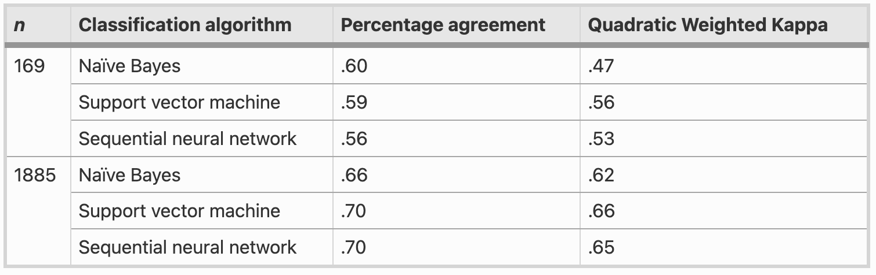
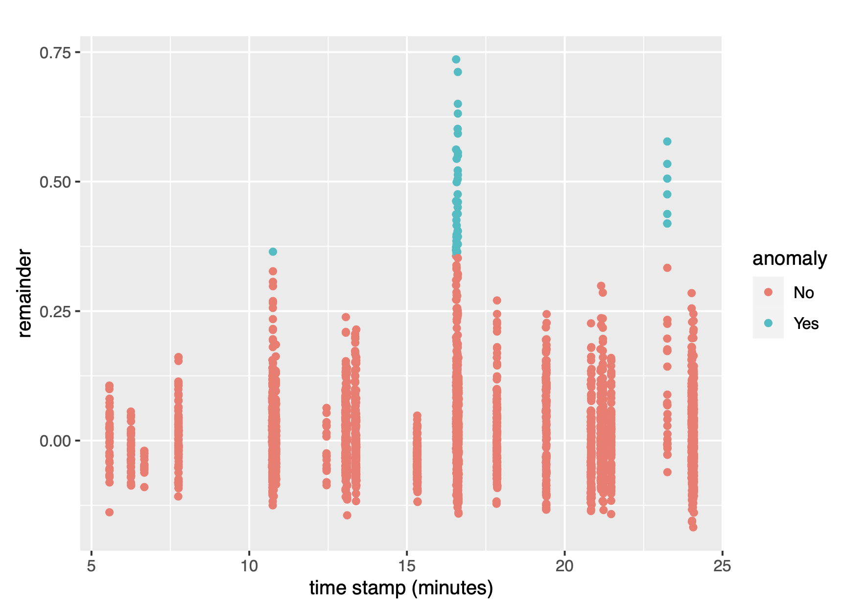
Combining qualitative and machine learning methods
Prior Research
Rosenberg & Krist (2021), Combining Machine Learning and Qualitative Methods to Elaborate Students’ Ideas About the Generality of their Model-Based Explanations
https://faast.shinyapps.io/generality-shiny/
Theory-based Computational Analysis of Classroom Audiovisual Data (NSF-supported)

Slide 26
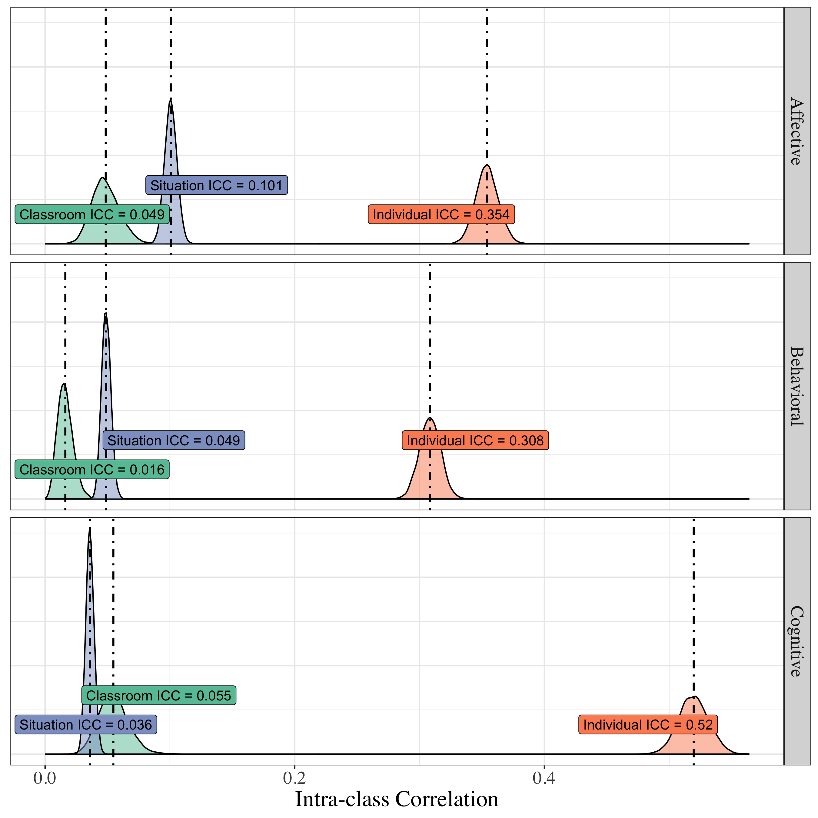
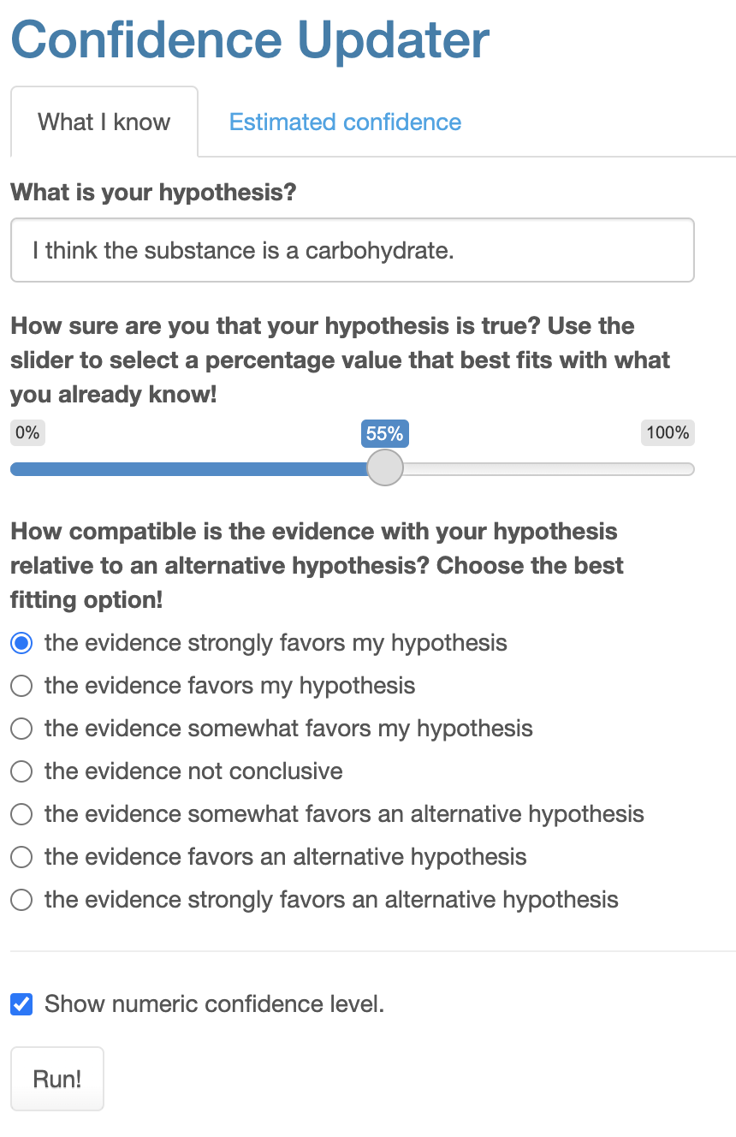
Supporting learners’ to use Bayesian methods
Prior Research
Rosenberg et al. (2022), Making Sense of Uncertainty in the Science Classroom: A Bayesian Approach
Rosenberg et al. (2020), How does situational engagement vary between learners, situations, and classrooms?

Slide 27
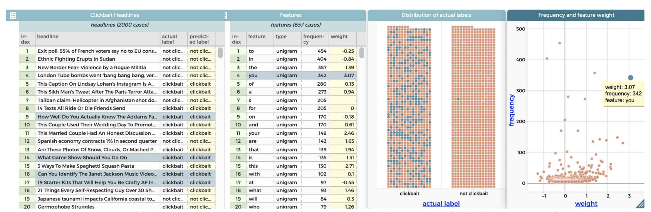
ML and AI Education
Prior Research
Understanding how students make informal predictions (Konold, 1989, Informal Conceptions of Probability)
Tatar et al. (2021), Modeling Unstructured Data: Teachers as Learners and Designers of Technology-enhanced Artificial Intelligence Curriculum

Slide 28
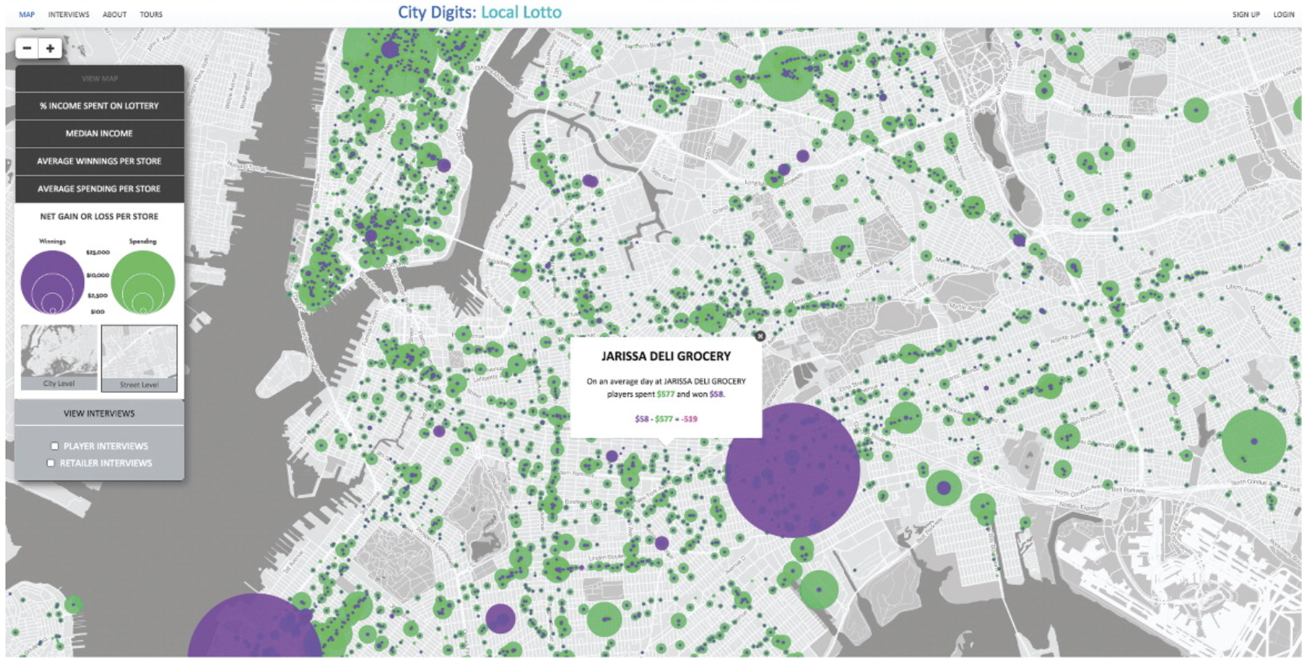
Data Science and Justice
Prior Research
“And notice it’s ranked number one in certain areas, right. Uh, ok and let’s look—so it’s orange around Inglewood and here this area between Compton and Carson.”
Philip et al. (2016), Becoming Racially Literate About Data and Data-Literate About Race: Data Visualizations in the Classroom as a Site of Racial-Ideological Micro-Contestations
Rubel et al. (2016), Teaching Mathematics for Spatial Justice: An Investigation of the Lottery

Slide 29
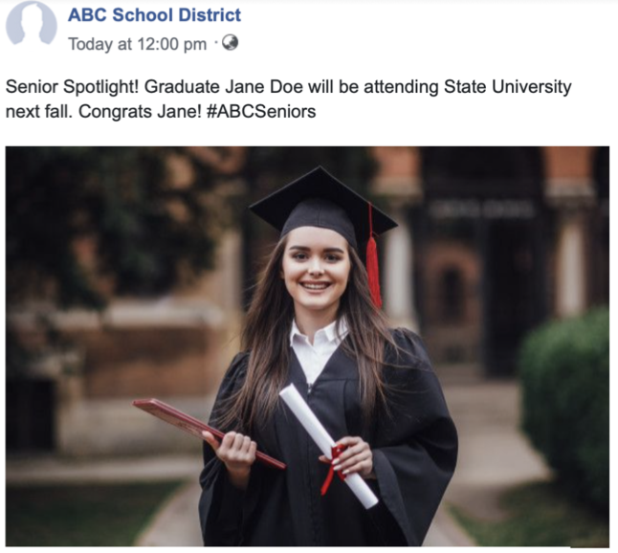
Science Education and New Forms of Media
Prior Research
Most participants in a Twitter-based network were involved in substantive conversations (Rosenberg et al., 2020, Idle chatter or compelling conversation?)
Posts on Twitter about the NGSS were very positive—much mores than posts about the CCSS (Rosenberg et al., 2020, The Next Generation Science Standards on Twitter)
Rosenberg et al. (2022), Schools' Posts on Facebook Systematically Risk Students' Privacy
Notes:
We found that around 4.9 million posts depict (show the face of) students in images. Furthermore, around 725,000 posts identify depicted students by first and last name.

Slide 30
Toward a Model

Slide 31
Back to the thesis
Toward a Model
Educational data science has a role in education, but how we do this work matters in terms of impact and sustainability over time
How should research related to data science in education progress?
Let’s try to model this (cf. Schwarz et al., 2009)

Slide 32
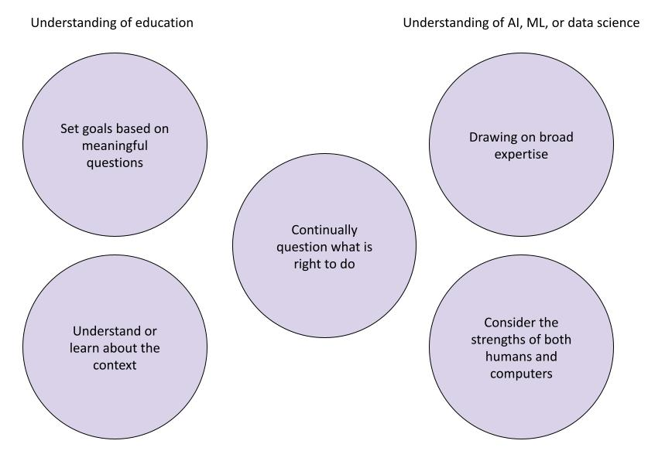

Slide 33
Why familiarity can matter
Conclusion
There is room for humans and computers in our work, but we need to know about both to be able to answer hard questions (Kubsch et al., 2022)
What are the tasks?
Who or what (human or computer) is doing which tasks?
Who or what should be doing which tasks?

Slide 34
Conclusion

Slide 35
Why familiarity can matter
Conclusion
More of us in education can have an active role in shaping how AI, ML, and data are used
We can ignore, embrace, or work out for which tasks under what conditions we should use these advanced technologies (Kissinger et al., 2022)
I look forward to learning with and from you about this topic and others over the upcoming days

Slide 36
Please share the questions or remarks you have!
Conclusion
Thank you kindly to:
Alisa Schmid and the the LEAD Scientific Coordination Team
LEAD members (special thanks to Christian Fischer)
LEAD Post-docs, Interns, and Students
Those hosting us in Untermarchtal
And the baker of the Dinkel Pur
Contact information:
Joshua Rosenberg, Ph.D.
https://joshuamrosenberg.com (slides posted here)
jmrosenberg@utk.edu

